Slide 1
Improving Deep Neural Networks
Deep Learning Specialization Report
Toshiba Software Development (Vietnam) Co., Ltd.
2021-10-05

Slide 2
Contents
01
Practical Aspects of Deep Learning
02
Optimization Algorithms
03
Hyperparameter Tuning, Batch Normalization and Programming Frameworks
04
Questions

Slide 3
Practical Aspects of Deep Learning
01

Slide 4
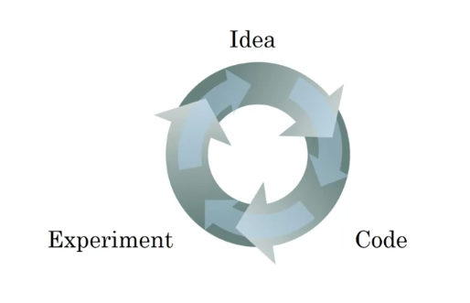
1.1 Train / Dev / Test sets
Applied Machine Learning (ML) is a highly iterative process.
Splitting into train, dev & test sets:
Training sets: to build model.
Dev sets (validation sets): to optimize hyperparameters
Test sets: try & evaluate.
Notes:
Dev & test set from same distribution.
The trend on the ratio of splitting the models:
100 ≤ #datasets ≤ 10^6 => 60%/20%/20%.
#datasets ≥ 10^6 => 98%/1%/1%.
Notes:
+ Quá trình: start idea (identify problems, proposal algorithms, design 1 nn) -> implement -> run & experiment get a result tell how well this particular networks or config. Try to find better neural network for application.
+ (?) làm sao để quá trình trên trở lên hiệu quả.
solve: setting dataset can make u more efficient.
+ same distribution:

Slide 5
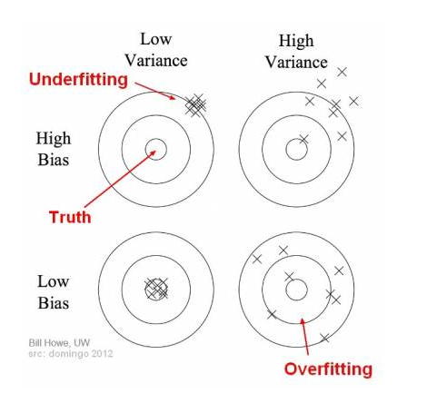
1.2 Bias/Variance (1)
Definition:
Bias: the difference between the average prediction & the correct value.
Variance: the variability of model prediction for a given data point which tells spread of our data.
Problems:
Overfitting: occurs when the gap between the training error & test error is too large.
Underfitting: occurs when the model is not able to obtain a sufficiently low error value on the training set.
The bias variance trade-off: try to find a good balance between bias & variance such that it minimizes the total error:
Total Error = ${Bias}^{2}$ + Variance + Irreducible Error (*)
Notes:
What
+ high bias -> models not focus training data & oversimplifies the model.
+ high variance -> du lieu thua thot
Why occur ?
+ capture: catch
+ overfitting: model learn the detail & noise in the training data to extent that it negatively impacts the performance of the model on new data.
+ underfitting: model too simple.
2) Model’s capacity la kha nang model “fit” nhieu loai functions.
Low capacity -> kho khan fit training data
High capacity -> overfitting ~ ghi nho cac dac trung cua training data ma k hieu qua tren test set.

Slide 6
1.2 Bias/Variance (2)
How to detect:
Overfitting: using k-folds cross validation:
One of the k-folds as the test set & the remaining folds as training set.
The process repeats util each of the fold has acted as a test set.
The scores are averaged to assess the performance of the overall model.
If the model performs better on the training set than on the test set => model is likely overfitting.
Underfitting:
Based off the training set.
How to avoid:
Overfitting:
Cross-validation
Early stopping
Train with more data
Data augmentation
Regularization
Underfitting:
Decrease regularization
Increase the duration of training
Feature selection
Notes:
What ?
+ control the capacity of learning algorithm = choosing “hypothesis space”.
Hypothesis space: the set all functions that can be returned by model.
- Example:

Slide 7
1.3 Basic recipe for machine learning
After having trained an initial model
High bias
1. Try bigger network
2. Train longer
3. Try difference NN architecture
Yes
No
High variance
1. More data
2. Regularization
3. Try difference NN architecture
Yes
Done
Notes:
Recipe: formula
Goal: both low bias & low variane

Slide 8
1.4 Regularizing
Regularizations are techniques used to reduce the error by fitting a function appropriately on the given training set & avoid overfitting.
Regularization for logistic regression:
Notes:
Overfitting: 2 solve regularization or more training data.

Slide 9
Thank you

